Slide 1
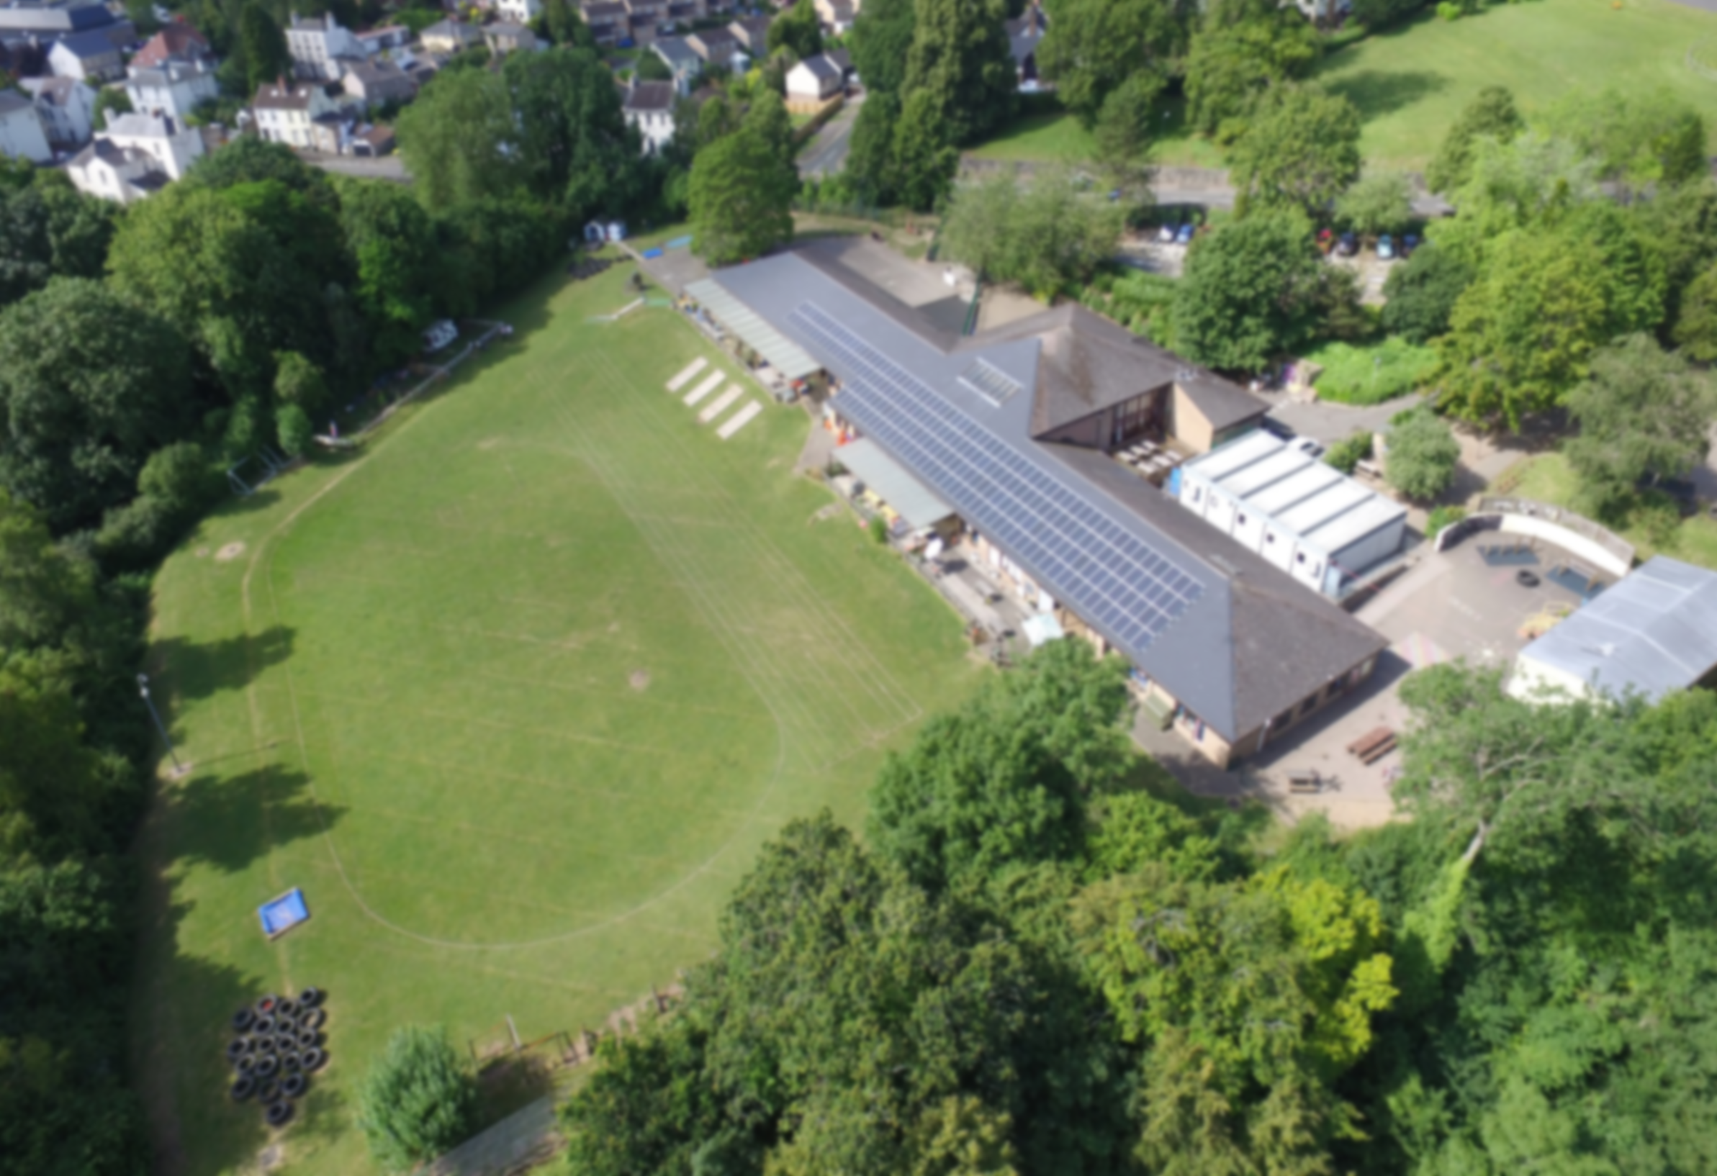



ALN and Barriers to Learning
Parent Presentation

Slide 2
School Context
The designation of an ALNCo does not remove the responsibilities of the wider workforce; all staff who work with children and young people with ALN have a responsibility for ensuring that their learners’ needs are identified and met
400 children on roll
2 form entry
Teaching Staff: 16
Senior Leadership Team:
Head Teacher – Mr M Adams
Deputy Head (ALNCo & Curriculum & Pedagogy Lead )
Progress and Assessment Lead
TA’s: 10
HLTA: 1 (ELSA and Wellbeing Lead)
ELSA: 3
The ALNCo is the individual who, at a strategic level, ensures the needs of all learners with ALN within the education setting are met.

Slide 3
From SEN TO ALN………
ALN reform since 2021
Changed from SEN to ALN
Implementation completed by August 2025.
https://www.gov.wales/additional-learning-needs-code
Welsh Government and Estyn are continuing to review the implementation process and the collective interpretation of the Code.

Slide 4
Who is classed as ALN on the new system?
Only children who have a school based or LA based IDP are classed as ALN!
If a child is CLA (In Care and Looked After) the LA will automatically write and hold the IDP
The ‘old’ SEN register is now called a ‘Barriers to Learning’ Register or a ‘Graduated Response’ Register – these children are NOT classed as ALN. They have a barrier to learning.
We also have a Disability Register

Slide 5
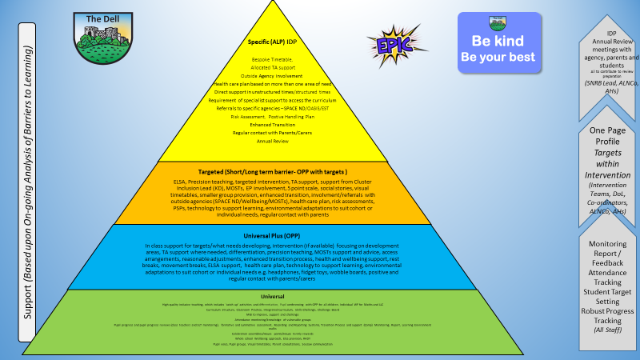
So how/who decides if a child has an ALN (an IDP) or a Barrier to Learning?
We use something called a ’graduated response’ or a ‘pyramid of need’
The class teacher is usually the person who raises a concern (but TA’s and parents can/do raise concerns – duty to decide process)
We use the pyramid to help determine what provision/support/intervention/reasonable adjustments needs to be made.
We also use a barriers to learning matrix, as well as teacher observations/progress data/books and advice from external agencies/professionals etc
Removing the Barriers to Learning Matrix - Live.docx

Slide 7
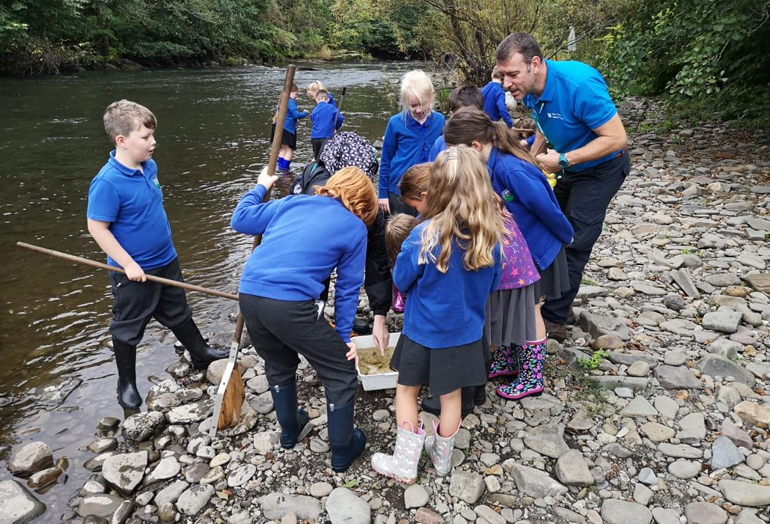
IDPs – Individual Development Plans
There will only be a small minority of children in schools who have an IDP – the top of the pyramid!
This means they have an Additional Learning Need that requires an ALP (Alternative Learning Provision)
These children usually require a very high level of adult support and need a bespoke, individualised timetable.
These children often have a Care Plan/Risk Reduction Plan/ Positive Handling Plan in place.
They are often, but not always, diagnosed with a medical condition/syndrome or have a form of neuro diversity. * Having a diagnosis does not automatically mean an IDP!
There is usually other agency involvement and referrals

Slide 8
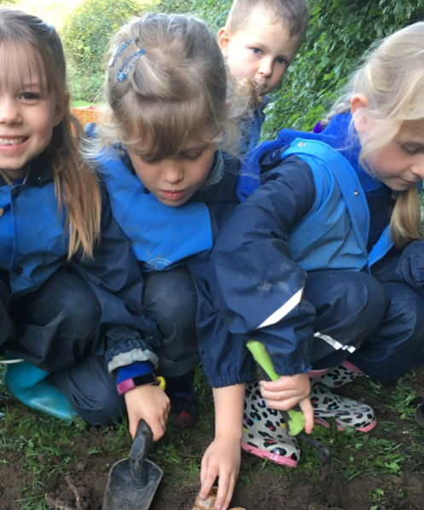
Barriers to Learning (the OPP)
Universal + and Targeted
The child is struggling more noticeably with a certain ‘area’ compared to their peers. They need work differentiated further than the usual differentiation, need a lot more support than other children. Parents may have raised concerns. A PCP meeting can be held to discuss these concerns and the needs identified.
This could fall under one or more of these areas……….
Cognition and Learning
SEMH (Social Emotional Mental Health)
Sensory and/or physical needs
Communication and Interaction
It is the teacher’s responsibility (with support and oversight by the ALNCO) to provide ‘reasonable adjustments’ within class to help support the child
These children will have a One Page Profile with targets that are set and reviewed each half term.

Slide 9



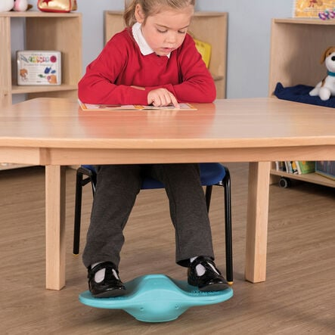
Reasonable Adjustments
Coloured overlays
Pencil grips
Wobble cushions
Sensory circuits
Ear defenders
Fidget toys
Seated in a certain place
Movement breaks/rest breaks
Intervention (within class and out of class)
A quiet space
Regular home-school communication
Access to some additional adult support as and when is needed
Technology to support learning (word to text)
Visual timetables
Now and Next boards
Timers
Break time ‘jobs’
Lego therapy
ELSA/Wellbeing Check ins
Sensory Room

Slide 10


Intervention and TA Support
The term 1:1 support is no longer used routinely, as evidence suggests it can sometimes have a negative impact on a child's independence and inclusion. Where a high level of additional adult support is required, we adopt a team around the child approach rather than relying on a single dedicated adult.
Across Monmouthshire, TA support in Years 3 to 6 is extremely limited. In most schools, no TA support is available for general classroom intervention, with existing provision largely directed towards pupils with complex additional learning needs who require substantial adult support.
Types of Intervention
Precision (reading and Maths)
Spelling
Phonics
Wellbeing Interventions
ELSA
Lego Therapy
Outdoor Nurture
Rainforest nurture
Wellbeing Check ins
Sensory room
Gardening Club
Responsibility for the progress of all learners rests with the class teacher, including pupils with ALN and those who face barriers to learning.
Due to funding pressures, TA support for interventions across Monmouthshire schools is severely compromised. This means I need to be strategic and creative in how Teaching Assistants are deployed to meet pupils' needs.
At The Dell, two Teaching Assistants provide intervention support across Years 3 to 6. In Reception to Year 2, year group Teaching Assistants also deliver interventions alongside their core classroom support role.

Slide 11

ALN Funding
70% on school numbers. 30% based on IDP’s
Delegated lump sum for a school to use as they see fit
Even if a child has an IDP they do not get funding (the old SEN system – chn who were statemented/SAPRA would get money assigned with them)
Schools can apply for ‘contingency funding’ if a child has extremely high needs that would require significant additional adult support. They have to meet a certain set of criteria.
Frustratingly, this criteria does not cover SEMH (social emotional mental health) or diagnosis of ASD/ADHD!
We are HUGELY under funded!

Slide 12
Referrals/Assessments
EP – Educational Psychologist – Dr Rob Brooks
MOSTs – Monmouthshire Specific Teaching Service (literacy difficulties)
NESH – ADHD/ASD referral pathway
SPACE Wellbeing – referral for parents with concerns about wellbeing, anxiety, challenging behaviour
CAMHS – InReach – Luke Coombestock
SPACE ND – ADHD and ASD referrals
Speech and Language
ComIT – Communication Intervention Team
OT
OASIS/EST (Education Support Team)
School Nursing Team
For referrals to meet threshold, there needs to be ‘evidence’ that different strategies/interventions have been tried in school over two review cycles.

Slide 13
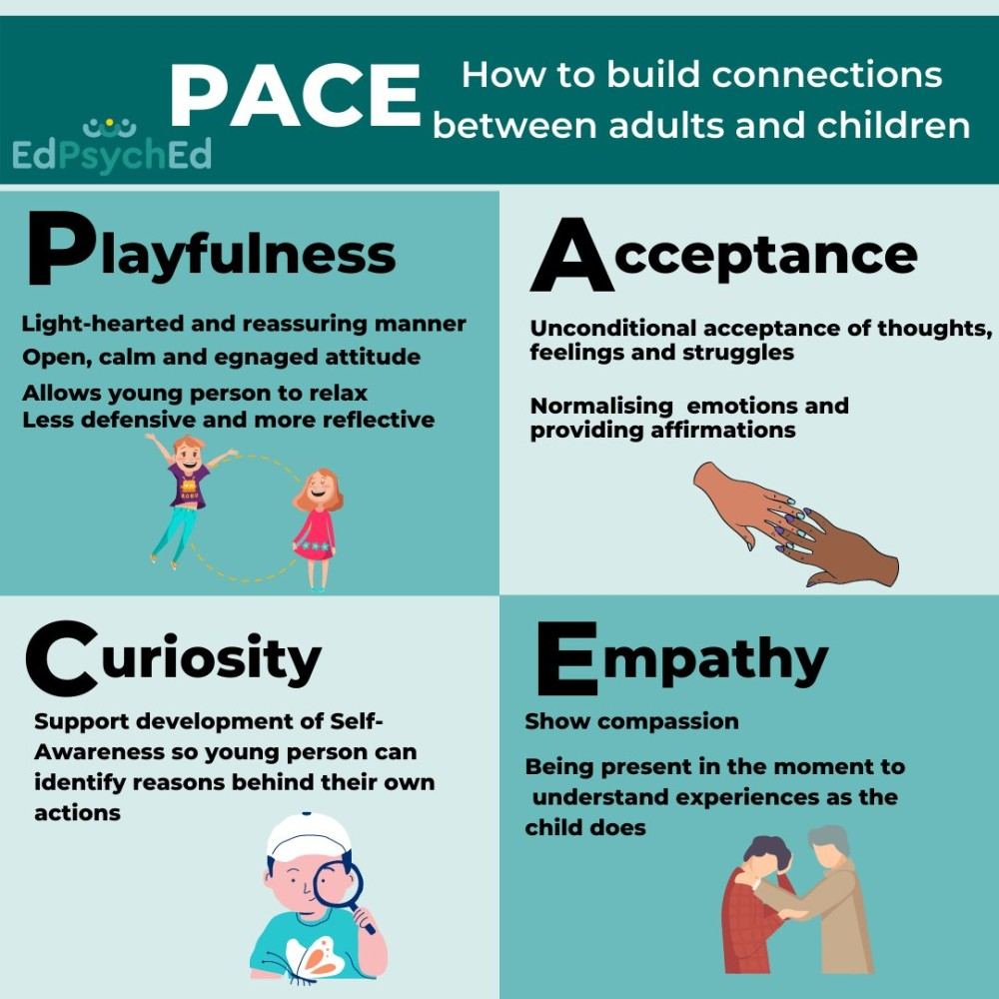



Staff Training/Professional Learning
Autism in Schools
Trauma Informed
MOSTs Training – Spelling and Reading
Regular ALN Update training
TEAM TEACH
ADHD
PACE (Playfulness Acceptance Curiosity Empathy)

Slide 14
Resources/LINKS
SPACE WELLBEING: https://abbhealthiertogether.cymru.nhs.uk/parentscarers/your-childs-mental-health/adviceself-referral-camhs
Parent Guidance:
https://www.gov.wales/moving-additional-learning-needs-aln-system-parents-guide-html
Child and Adolescent Mental Health (CAMHS) - Aneurin Bevan University Health Board
ALN Monmouthshire
https://www.monmouthshire.gov.uk/additional-learning-needs/
ND
https://www.youtube.com/results?search_query=nessy+subscribe
https://www.youtube.com/@goHairy
Home - Neurodiversity Gwent
https://www.nessy.com/en-gb/dyslexia-explained/free-learning-resources/teaching-videos

